Slide 1

Topics

Slide 2
Why are you being asked to take Capital Equipment Policy training?
As a recipient of Federal funding, tracking capital equipment is a requirement per the auditing guidance contained in Uniform Guidance CFR 200.313/200.39 and is a best practice for any business entity.
It's necessary to protect all MBL assets. As part of the requirement, you are required to sign off on this training/policy because you are currently or may become connected with either purchasing, using, installing, caring for or maintaining capital equipment at MBL. When equipment is purchased, disposed of, or transferred, you have a critical role in the tracking process.
Introduction

Slide 3
Property Terms
Property Custodian - staff member responsible for the management of capital equipment assigned to them
Property Coordinator - staff member assigned in each Center/Department to manage the total capital equipment list of their Center/Department
Disposition - parting with, alienation of, or giving up of property
Inventory - a complete list of items such as property, goods in stock, or the contents of a building
Physical inventory - a process of physically identifying and recording the whereabouts and condition of each piece of capital equipment

Slide 4
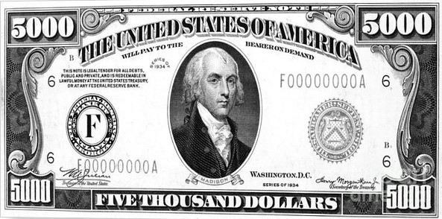
Capital Equipment
As defined by MBL, capital equipment meets the following criteria:
• Non-expendable, tangible property;
• Useful life of more than one year; and
• Original acquisition cost* of $5,000 or more
Capital equipment can be purchased with:
• Sponsored program funds (e.g. grants, contracts)
• MBL endowment funds
• MBL gift funds
• MBL unrestricted operating funds
Capital equipment can be received as a:
• Gift/donation
• Transfer from another institution
*The total cost of capital equipment includes the costs of shipping, in-transit insurance, multiple items purchased on one purchase order that work together as a single unit with a combined cost of $5,000 or more, any modifications or accessories necessary to make the equipment usable, and operating software purchased with hardware with a combined cost of $5,000 or more.

Slide 5
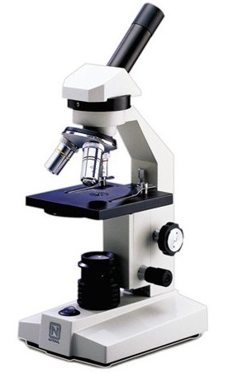
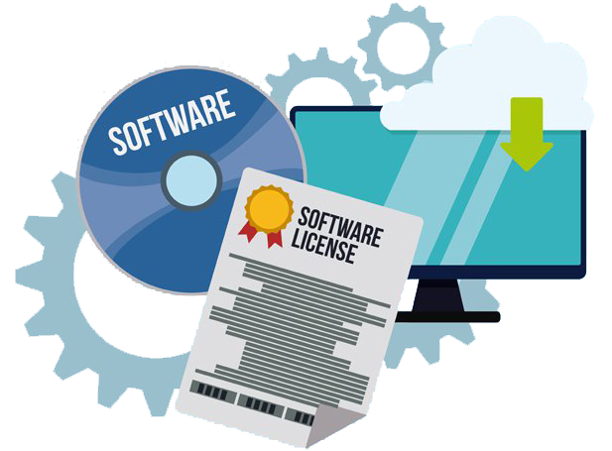
Examples of Capital Equipment
Examples of Capital Equipment:
scientific Equipment
office equipment
computers and peripheral equipment
vehicles (e.g. cars, trucks) and vessels
fabricated/constructed equipment
Examples of items/services that are NOT Capital Equipment:
extended warranty
maintenance agreement
software license
replacement parts
repairs
training/familiarization
tools costing <$5,000 needed for constructing equipment

Slide 6
Capital Equipment Policy
• All equipment owned by the MBL is subject to this MBL policy
• The safeguarding and use of movable equipment is the responsibility of the
Custodian
• The purchase of equipment with MBL funds for personal or private use is
prohibited
• Financial Services is responsible for maintaining a "fixed asset ledger" of all
capital assets owned by the MBL
• The Core Facilities Administrator is responsible for tagging capital equipment
and maintaining an equipment inventory database in accordance with this policy
• The Core Facilities Administrator, Development Office and Financial Services
must be notified of all gifts of equipment that have been received by any MBL
employee or office
• The Core Facilities Administrator must be notified of any changes in status of
equipment such as relocation or disposal. All changes in status are to be
recorded in the Financial Service's fixed asset ledger and the Equipment
Inventory Database

Slide 7
Duties of a Custodian
Notify Property Coordinator or Core Facilities Administrator when capital equipment ...
• Is received
• Moves from one location to another within MBL or to field
sites
• Is sent out for repairs
• Is loaned to another entity
• Needs to be disposed of
*All capital equipment notifications can be sent to
capitalequipment@mbl.edu

Slide 8
Duties of a Property Coordinator
Property Coordinator works with Core Facilities
Administrator when ...
• Capital equipment is received; arranging to have the item
tagged.
• Preparing required forms for disposition, transfer or loan of
equipment.
• Equipment moves from one location to another within MBL
or to field sites.
• Annual inventory is being conducted.
*All capital equipment notifications can be sent to
capitalequipment@mbl.edu

Slide 9
Annual Physical
Inventory
MBL conducts an annual physical inventory
• Property Coordinators are provided a current list of all capital
equipment assigned to their Center/Department
• Property Coordinators meet with each Custodian to locate all
items on the list
• Updates are made to items regarding condition of the
equipment, location, etc.
• Property Coordinator initials the list to validate inventory
• Core Facilities Administrator updates "last inventory date" in
central database; makes any updates as identified during the
physical inventory

Slide 10
Key Takeaways
• All capital equipment notifications and communications should be
sent to capitalequipment@mbl.edu
• A custodian is someone who has property assigned to them
• As a custodian, you are responsible for the whereabouts and
security of MBL equipment
• You are required to notify your Property Coordinator or the Core
Facilities Administrator if the equipment changes location
• A physical inventory will be conducted annually where you are to
acknowledge the location and working functionality of the equipment
assigned to you
• If the equipment should be disposed of, you will fill out
the required form
• If you leave the MBL, you will need to transfer
ownership to a new custodian
• Refer to MBL Policy E.1.3 -Capital Equipment Management

